Slide 1
Chapter 39

Slide 2
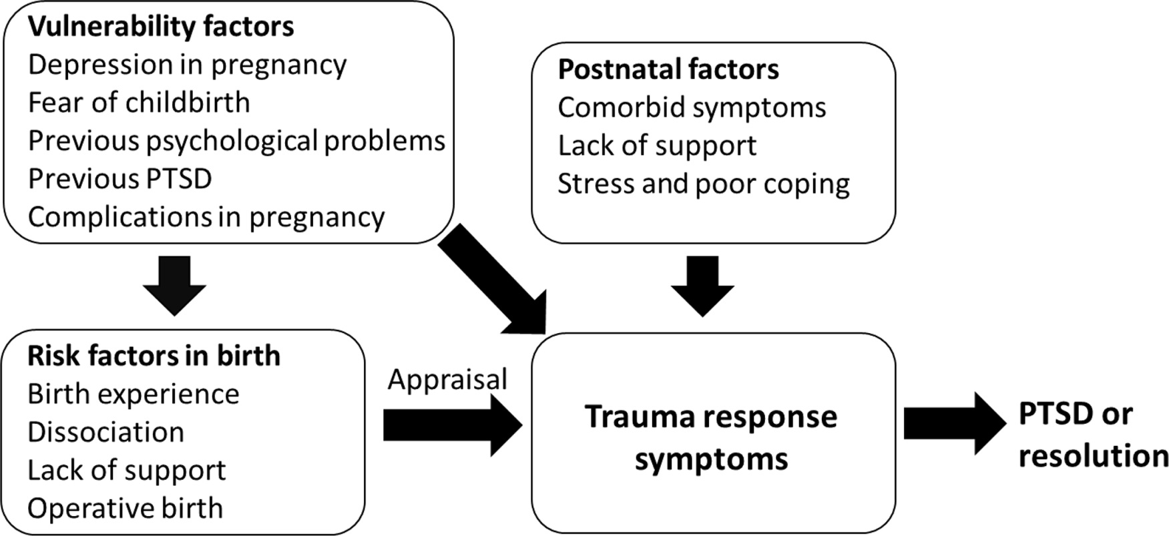
Figure 1 Diathesis-stress model of postpartum PTSD (Ayers et al., in press).

